Slide 1





Bytewise ltd
Data Engineering Fellowship
Presented By
AJAB NAUMAN

Slide 2
Data Engineering Basic Concepts
Technologies
Projects
Sessions
Certifications
Agenda

Slide 3
Data Engineering
Basic Concepts

Slide 4


Data Warehouse
Centralized storage system that allows for the storing, analyzing, and interpreting of data in order to facilitate better decision-making.
Transactional systems, relational databases, and other sources provide data into data warehouses on a regular basis.
While a traditional data warehouse stores data in hierarchical dimensions and tables.

Slide 5

Data Lake
A data lake is a storage repository that holds a vast amount of raw data in its native format until it is needed for analytics applications.
A data lake uses a flat architecture to store data, primarily in files or object storage. That gives users more flexibility on data management, storage and usage.
Data lakes are often associated with Hadoop systems.

Slide 6

Delta Lake
Delta Lake is an open-source storage layer that brings ACID transactions to Apache Spark and big data workloads.
ACID means atomicity, consistency, isolation, and durability.

Slide 7

ETL
Extract
Load
Data Extraction from its original source
Load data into the target database
Transform
Data Transformation by deduplication, combination, and ensuring quality.

Slide 8
Technologies

Slide 9



Azure Databricks
Glue & Crawler
Basic &
Intermediate
Queries

Slide 10
Databricks
Setup System
Data Ingestion
Data Presentation
Data Processing
Data Ingestion: CSV Files, Json Files, Multi Files
Data Processing: Filtering, Joins and Aggregation Transformation
Data Presentation: Data Analysis
Incremental Load

Slide 11
AWS
Upload Raw Data in S3 Bucket
Crawl Data Using Glue Crawler
Apply Transformation Using Glue Studio
Write Processed Data in S3 Bucket as CSV Files
Raw Data: CSV Files
Data Transformation: Apply changes on data set schema and SQL queries

Slide 12
SQL
1
Basic SQL
2
Functions
I learned basic syntax, retrieve, update, delete, etc.
Use of “WHERE” Clause.
I learned use of different aggregate functions with “Group By” Clause.
3
3
Joins
I learned use of different Joins like Inner, Left, right.

Slide 13
Sessions

Slide 14
Sessions
1
Azure Fundamental
2
Azure Data Fundamental
3
Databricks Fundamental

Slide 15
Certifications

Slide 16
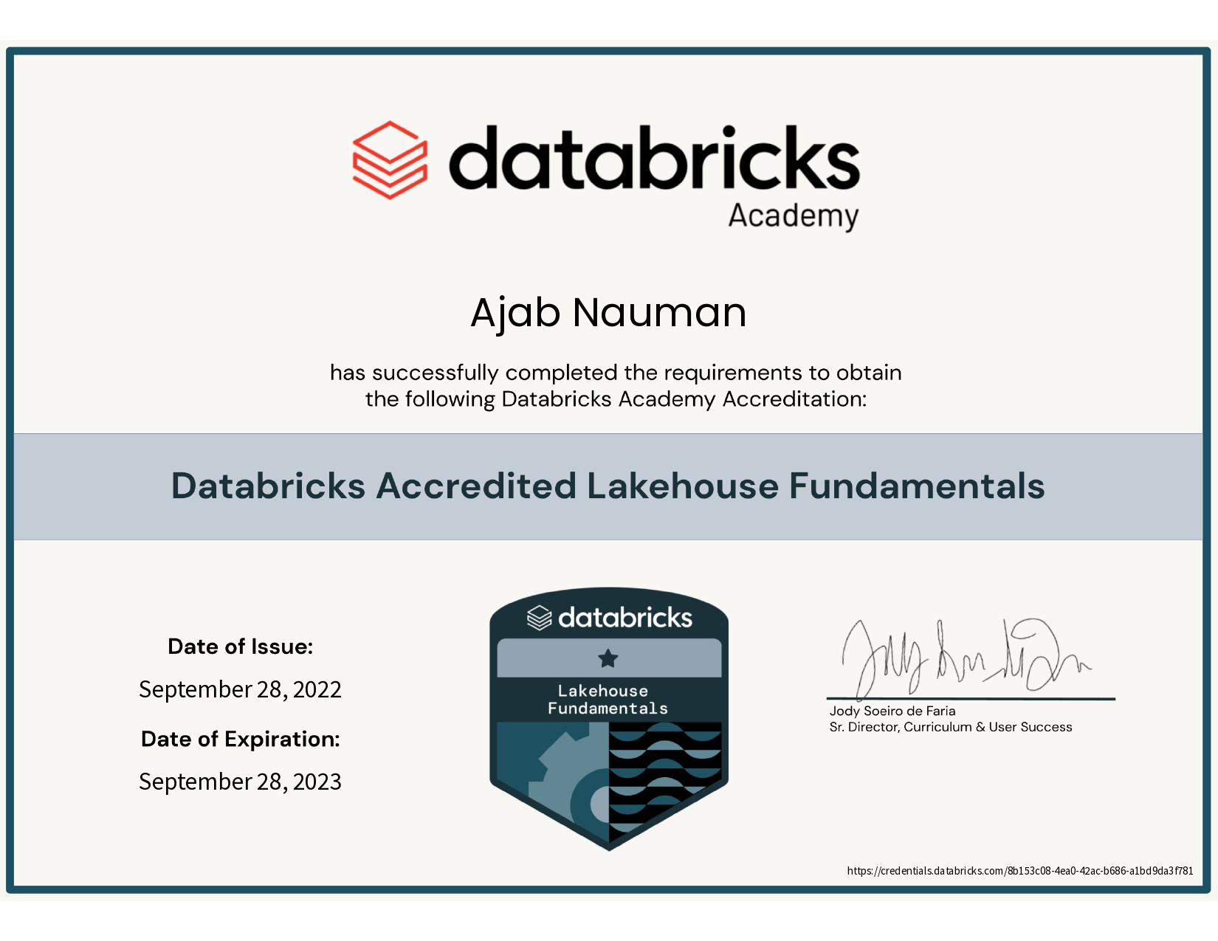
Azure Data Bricks

Slide 17
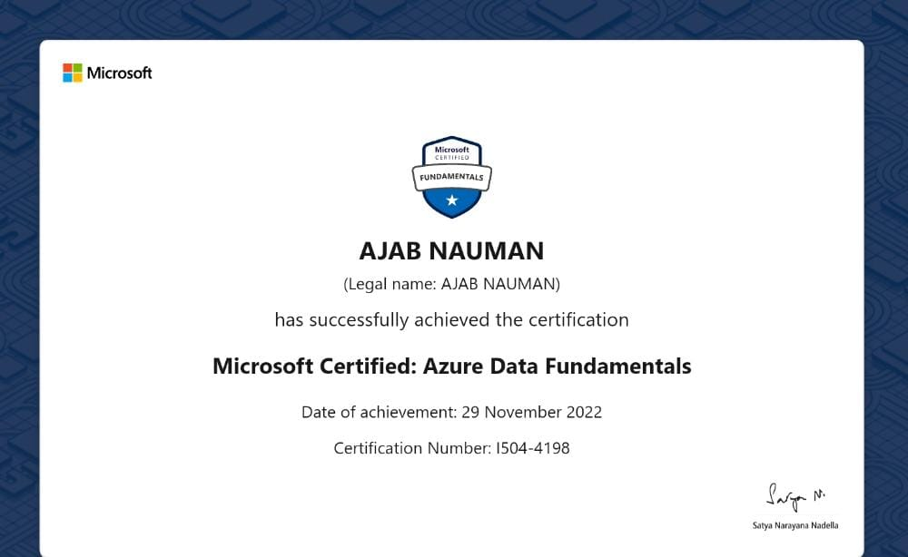
Azure Data Fundamental

Slide 18
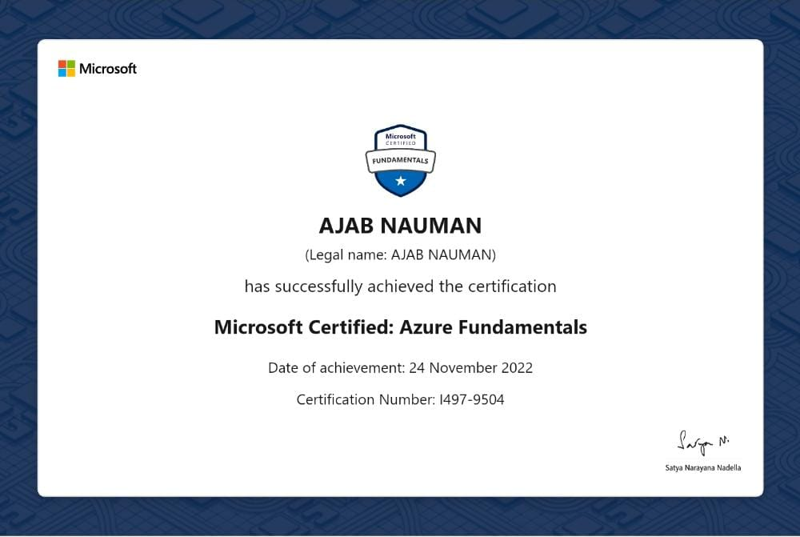
Azure Fundamental

Slide 19
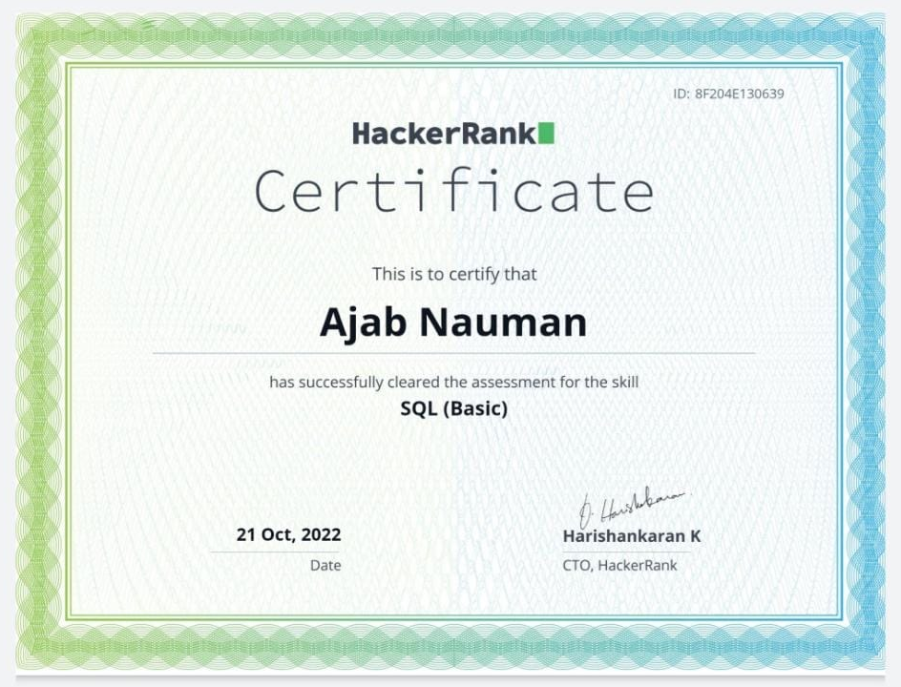
Hacker Rank SQL Basic

Slide 20
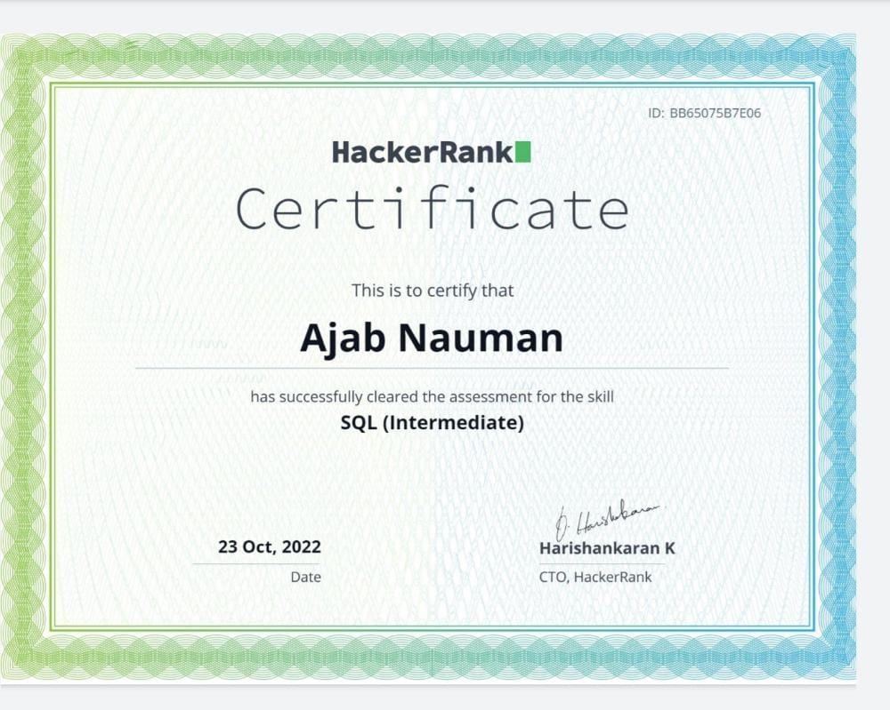
Hacker Rank SQL Intermediate

Slide 21
Thank you

